Slide 1
Retrieve Roads from Aerial Imagery Using Deep Learning
Capstone Project Mid-Point Presentation, CPLN 680, Spring 2022, UPenn
Jiamin Tan

Slide 2
Object
Learn how to train a neural network to detect roads from aerial images.

Slide 3
Object
Learn how to train a neural network to detect roads from aerial images.
Current Status:
I am learning ☺
but my algorithm is not learning ☹
which means both of us haven’t learnt enough so far…

Slide 4

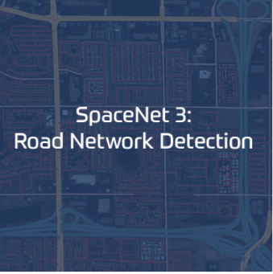
Main Data Source
https://spacenet.ai/

Slide 5
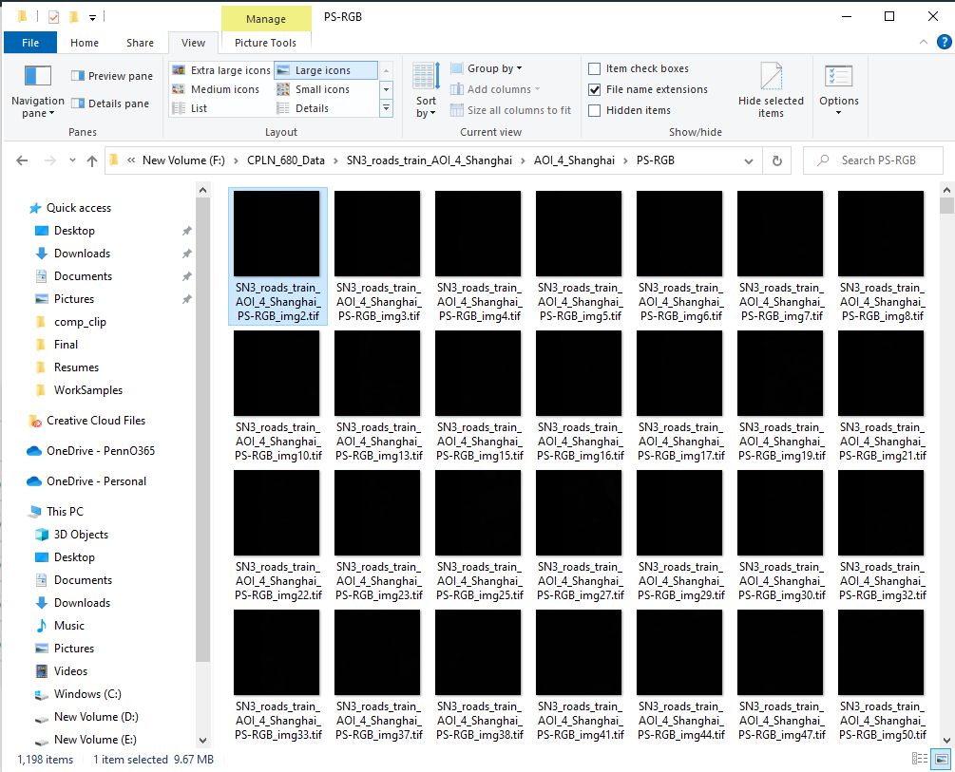
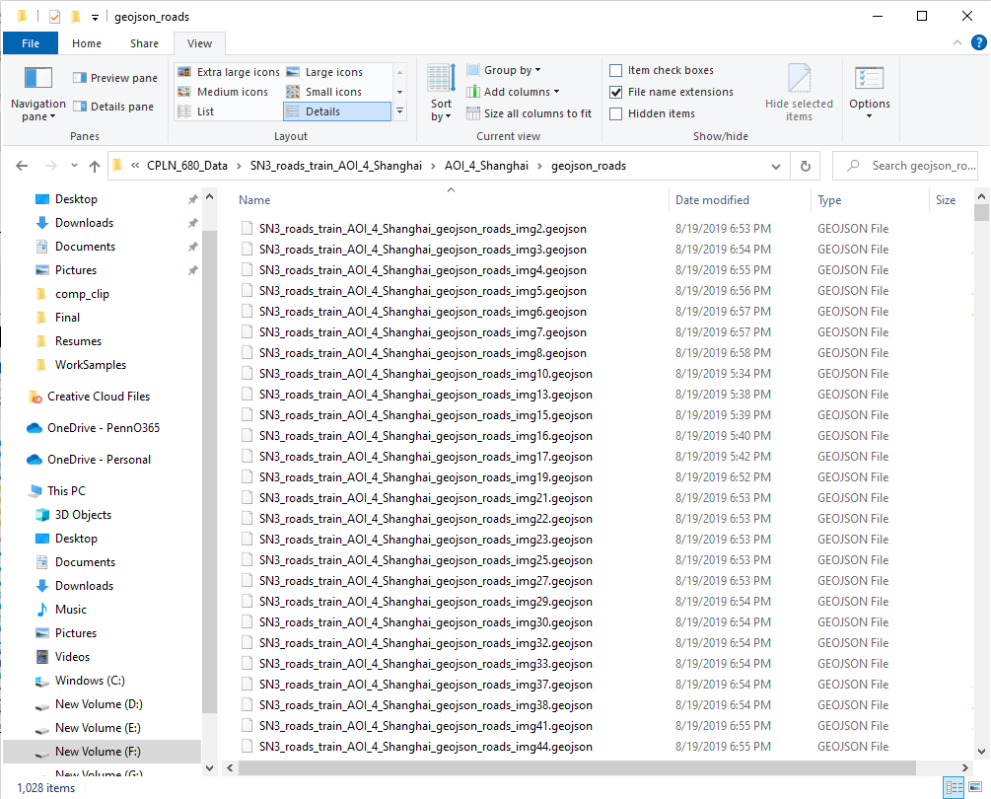
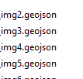
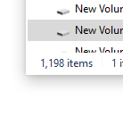
Training Image Set
.tif files stored satellite images.
Labels
.geojson files stored strings (roads) as
ground truth.

Slide 6
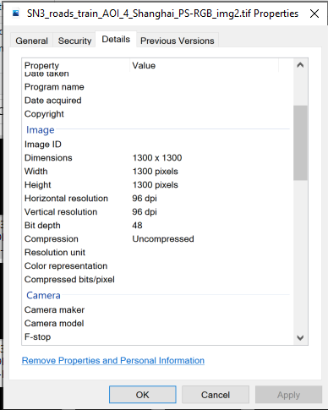
Training Image Set
For each pan-sharpened Image:
1300 x 1300 pixels.
Each pixel has a spatial resolution of
0.31m x 0.31m.
Each tile is, therefore, 400m x 400m.
Bit depth is 48, so 16 bit for each band, and the value of a pixel in each band is from 0 to 65535.

Slide 7
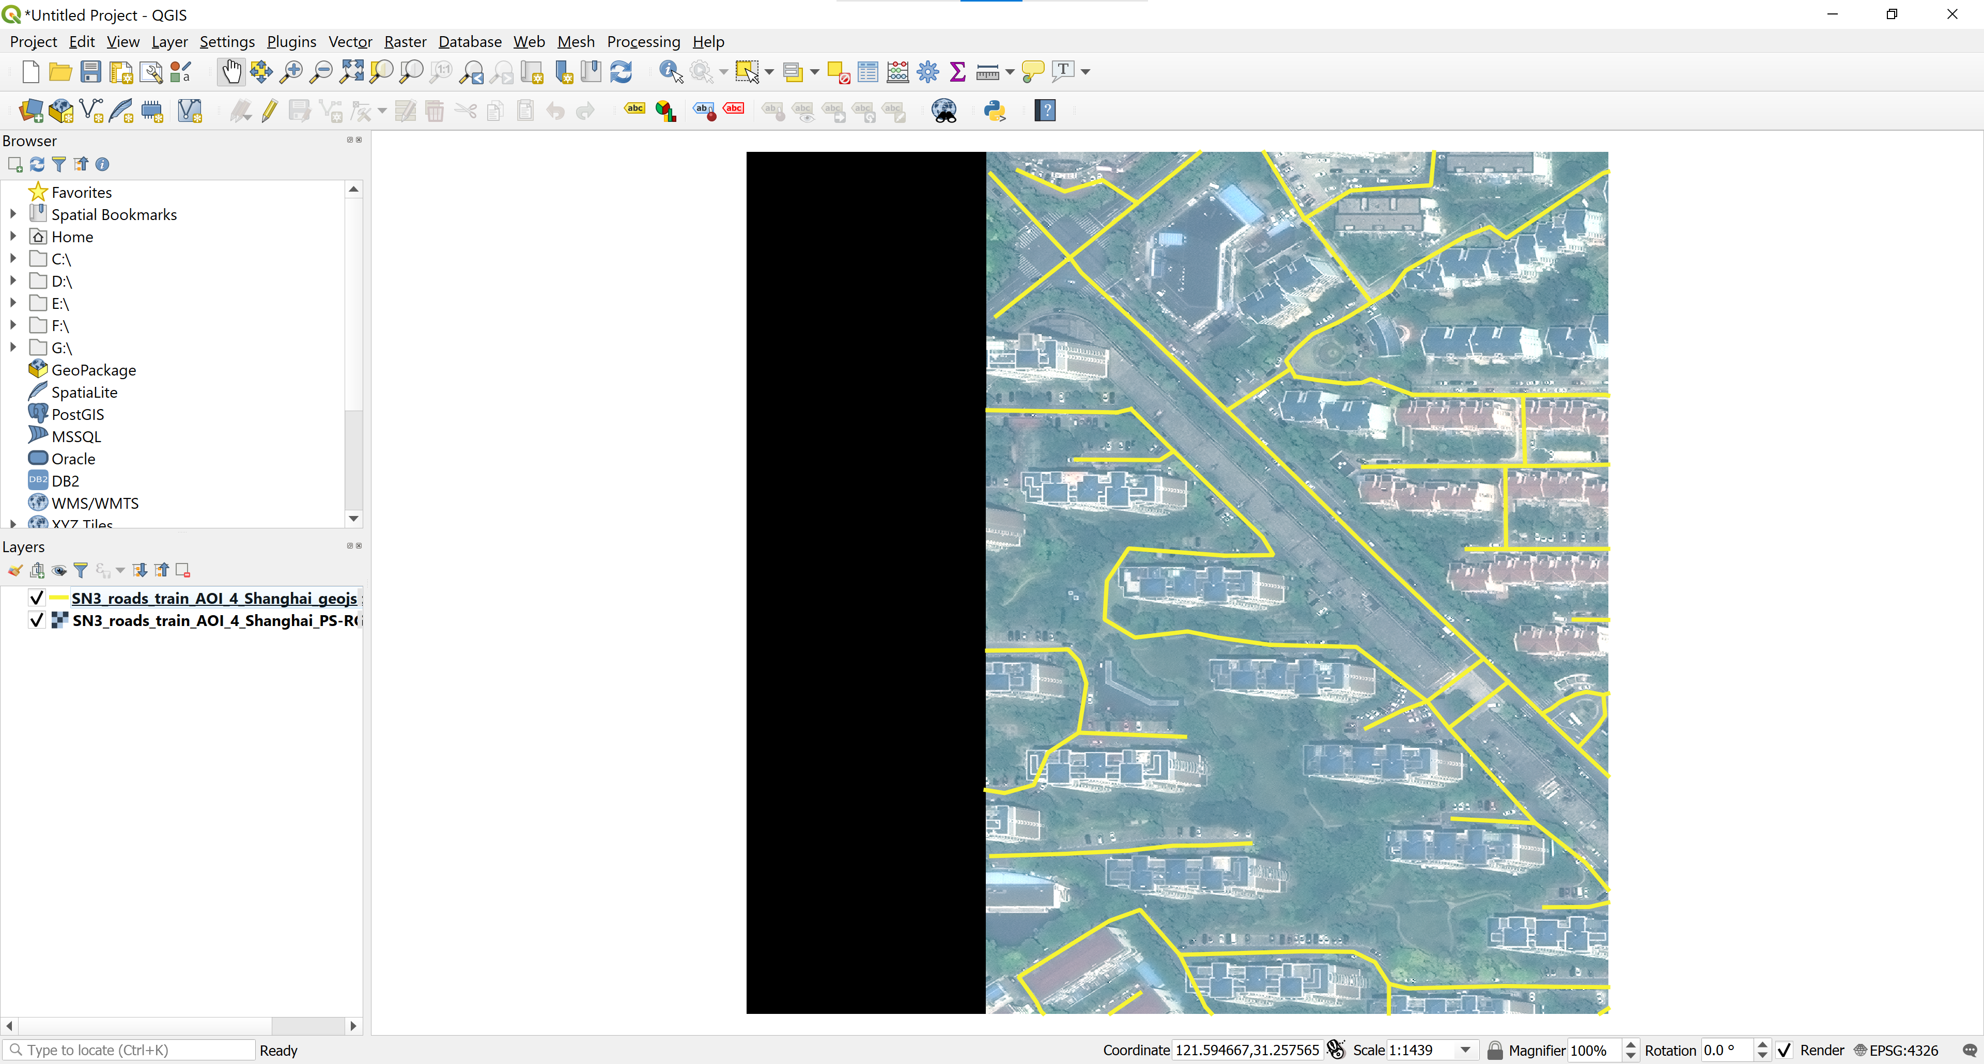
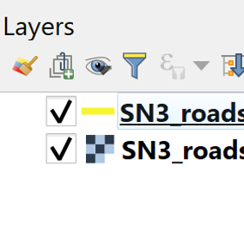

Slide 8
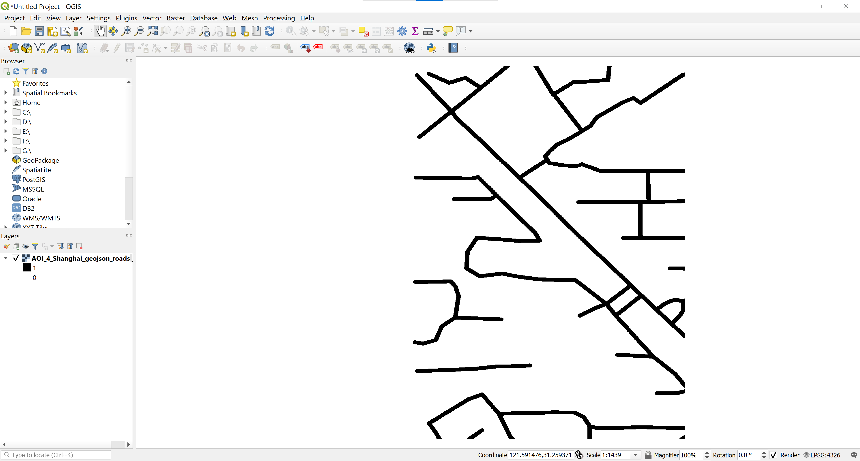
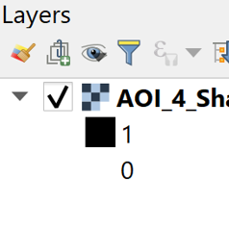
Create Binary Masks

Slide 9
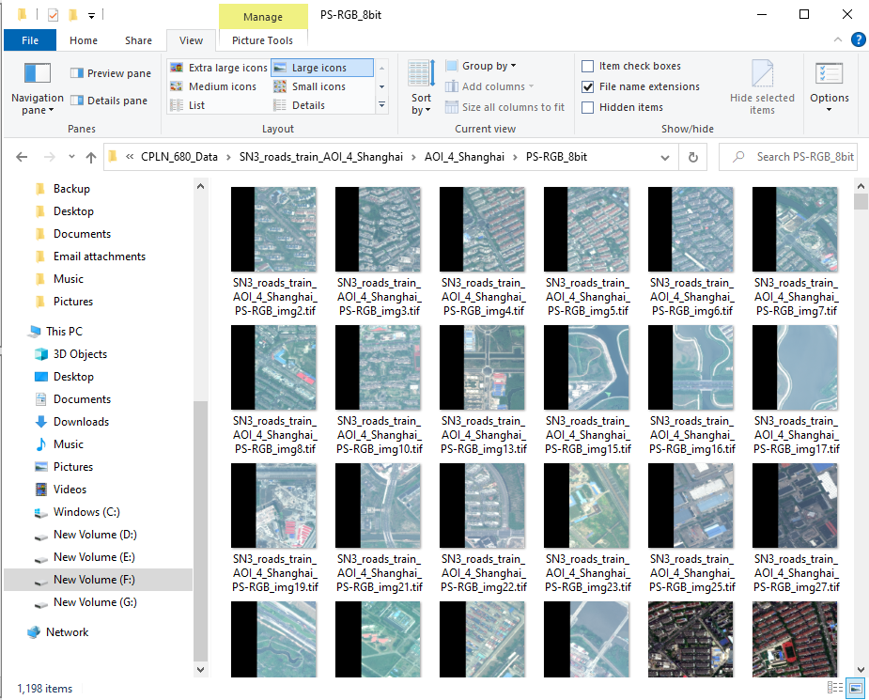
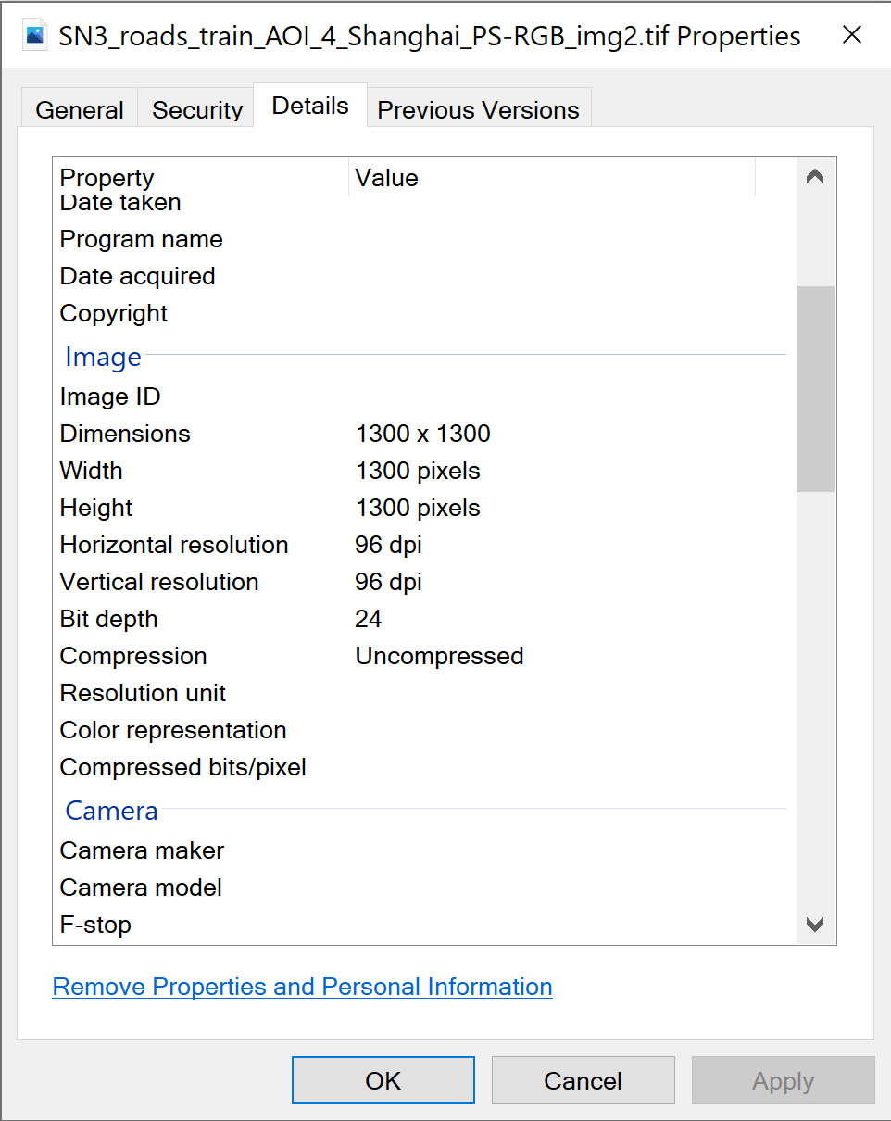
Training Image Set (8-bit)
Each Image Now:
1300 x 1300 pixels.
Each pixel has a spatial resolution of
0.31m x 0.31m.
Each tile is, therefore, 400m x 400m.
Bit depth is 24, so 8 bit for each band –
value of a pixel in each band is from 0 to 255.
Create 8-Bit Images

Slide 10
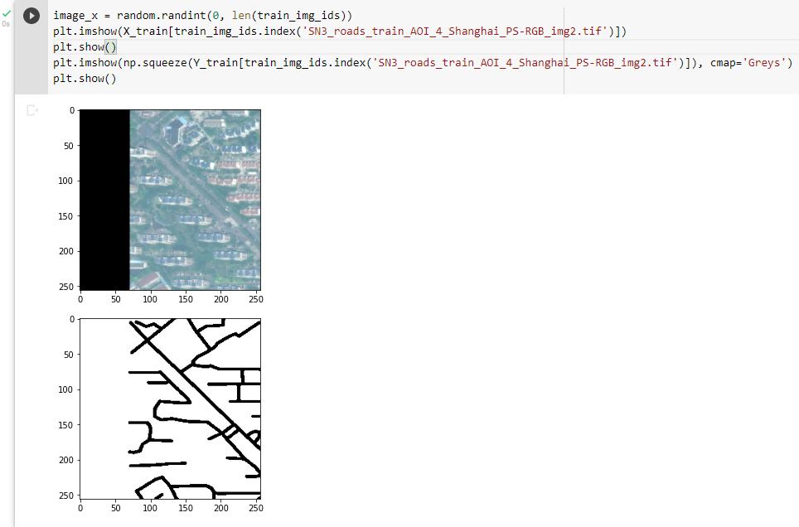
Load Training Set into Python

Slide 11

U-Net by Ronneberger et al. (2015)
https://lmb.informatik.uni-freiburg.de/Publications/2015/RFB15a/

Slide 12
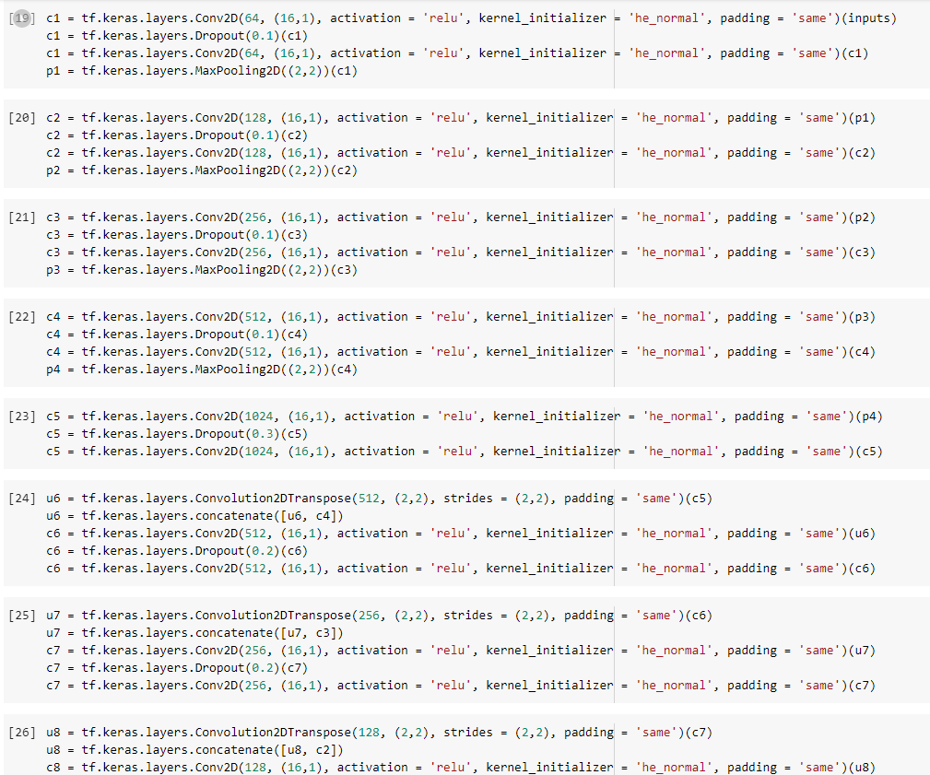
Hard Code U-Net Using Keras
Codes learnt from: Sreenivas Bhattiprolu, https://www.youtube.com/playlist?list=PLZsOBAyNTZwbR08R959iCvYT3qzhxvGOE

Slide 13
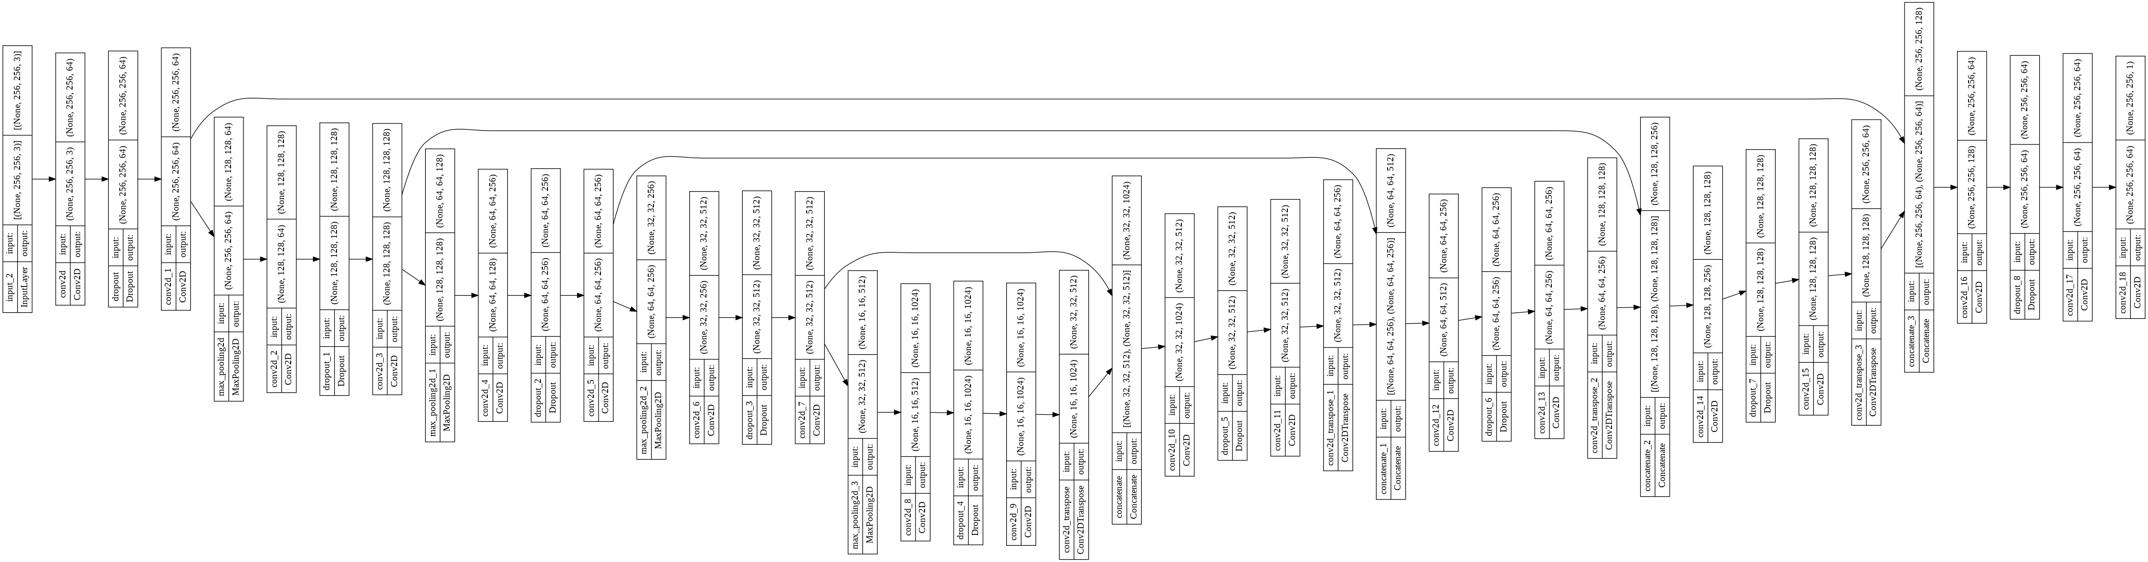
Hard Code U-Net Using Keras (Cont.)

Slide 14
Each Image After Resizing:
256 x 256 pixels.
Each pixel has a spatial resolution of
1.56m x 1.56m.
Each tile is, still, 400m x 400m.
Bit depth is 24, so 8 bit for each band –
value of a pixel in each band is from 0 to 255.
Train 100 images with reduced size (256, 256)

Slide 15
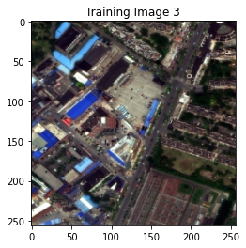
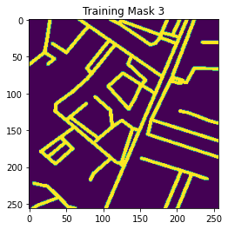
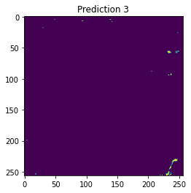
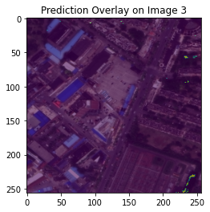
The results are not good (threshold = 0.5)…

Slide 16
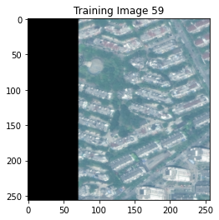
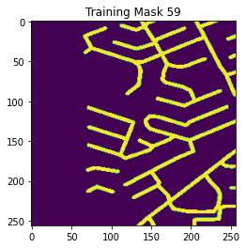
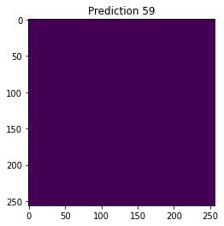
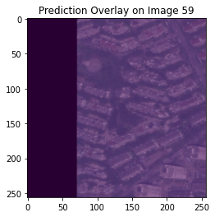
The results are not good (threshold = 0.5)…

Slide 17
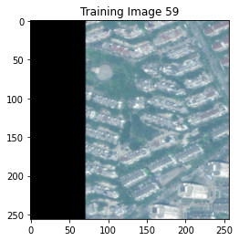
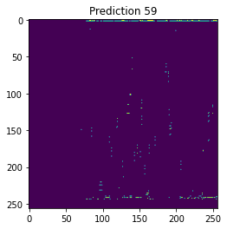
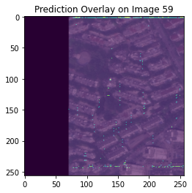
The same training image in another run (threshold = 0.5)…

Slide 18
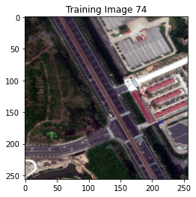
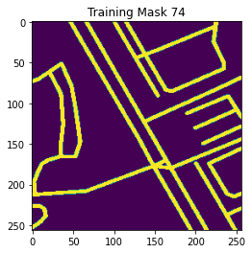
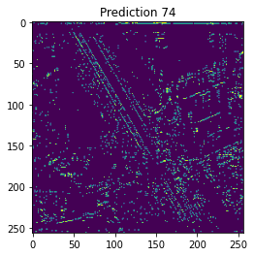
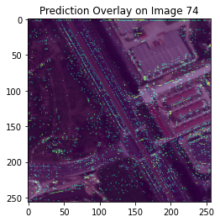
Sometimes it sort of learnt (threshold = 0.5)…

Slide 19
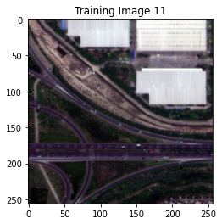
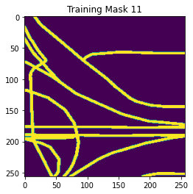
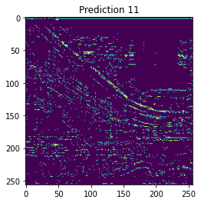
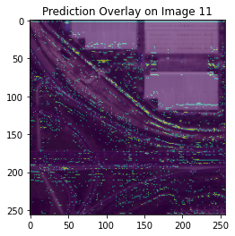
Sometimes it sort of learnt (threshold = 0.5)…

Slide 20
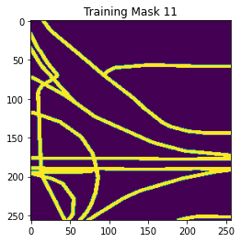
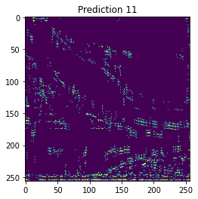
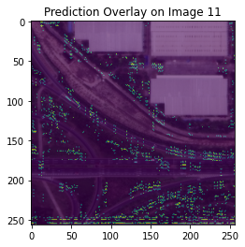
Or it learnt the wrong thing in another run (threshold = 0.3)…

Slide 21
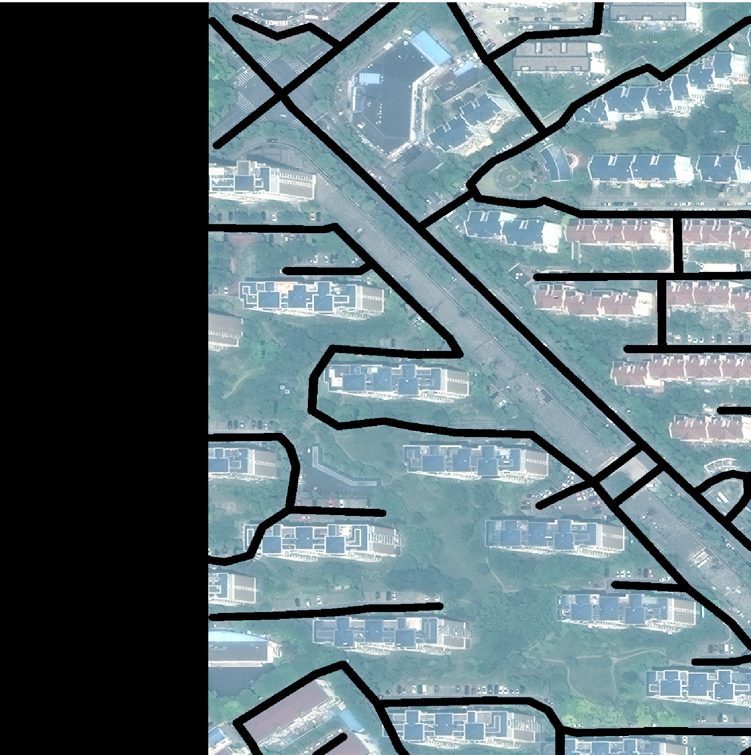
Hidden Layer
…
…
…
…
A (16, 1) instead of (3, 3) Kernel (not in real scale)

Slide 22
Hidden Layer
…
…
…
…
A (16, 1) instead of (3, 3) Kernel (not in real scale)

Slide 23
Hidden Layer
…
…
…
…
A (16, 1) instead of (3, 3) Kernel (not in real scale)

Slide 24
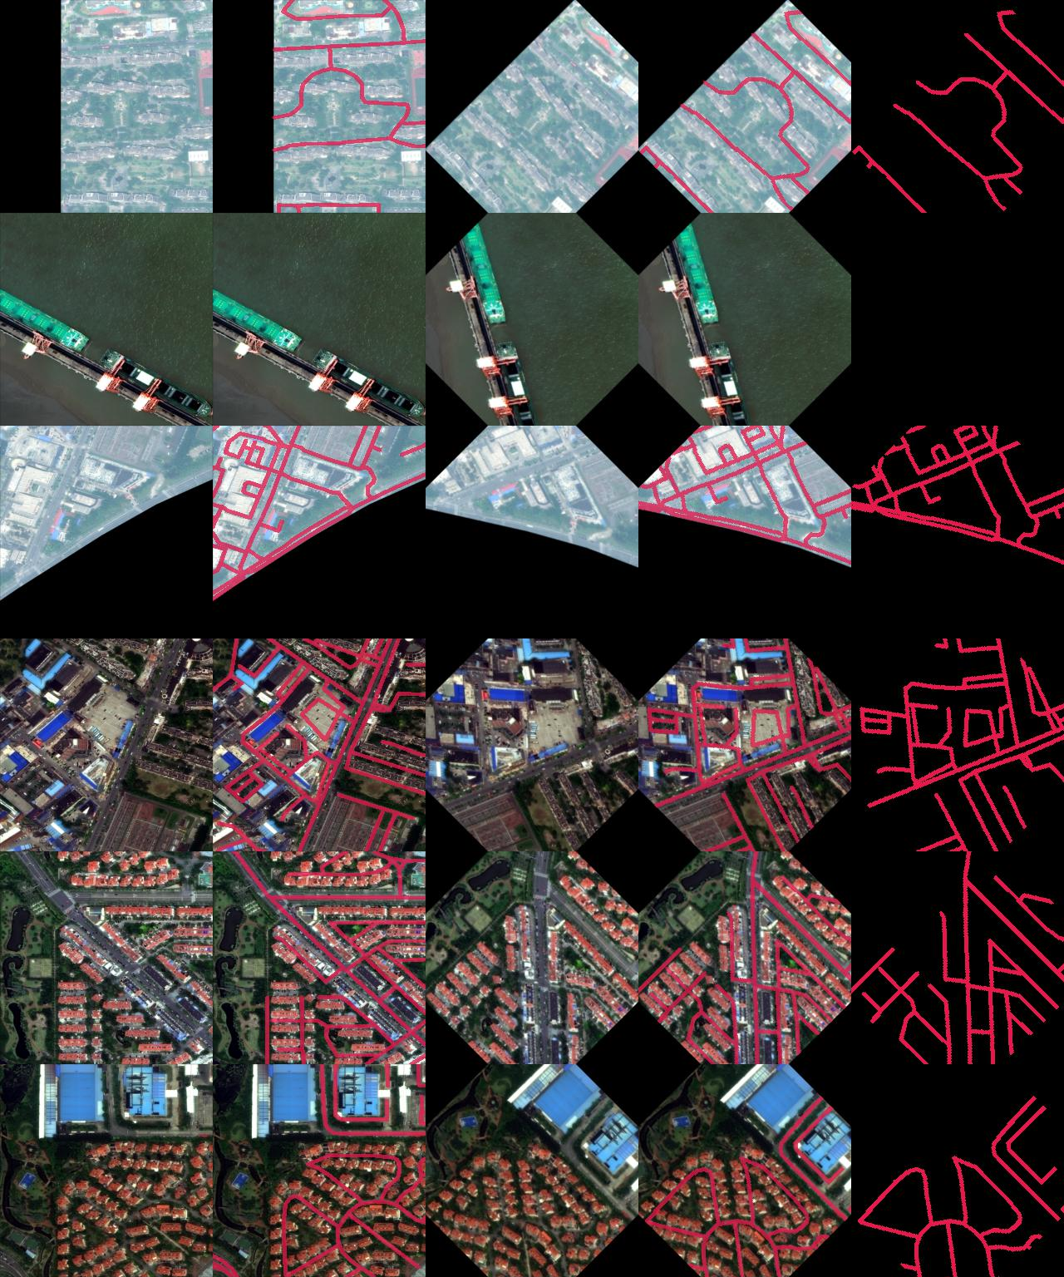
Some Directions for the Next Step
Rotate the images for augmentation
Figure out a suitable kernel size
Create buffers by road type
Learn about transfer learning which uses pre-trained models
Read more papers on road segmentation
Try to train more images

